Slide 1

Using customer lifetime value and neural networks to improve the prediction of bank deposit subscription in telemarketing campaigns

Slide 2
● performing a feature forward selection procedure, in an attempt to enhance the original model (from the previous research) by adding client history features, such as RFM.
● comparing the proposed approach with previous research (used as a baseline) and analyze the improvement achieved in the light of LTV relevance.
● finally, showing how the model using customer history information might benefit the bank telemarketing business in terms of targeting.

Slide 3
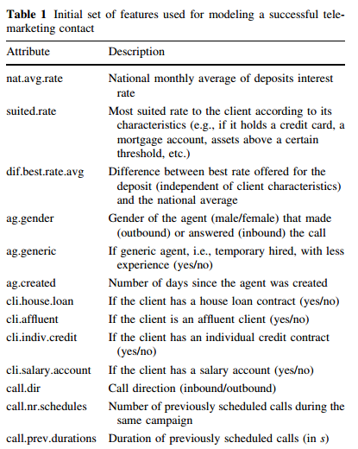
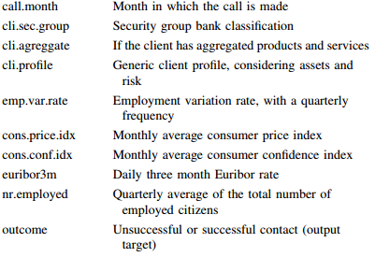

Slide 4
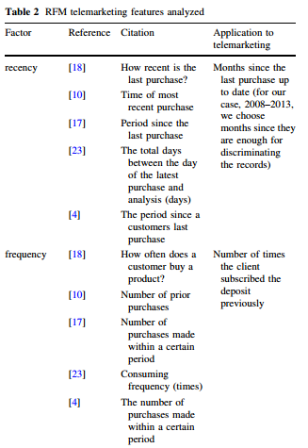
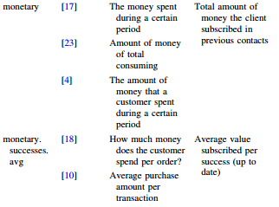

Slide 5
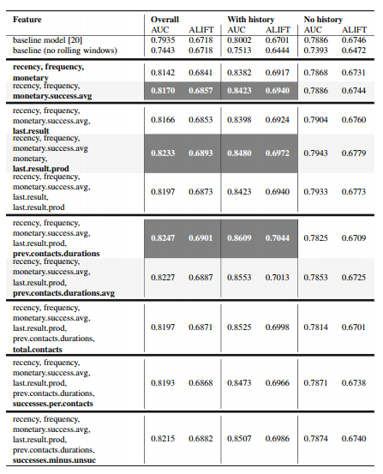

Slide 6
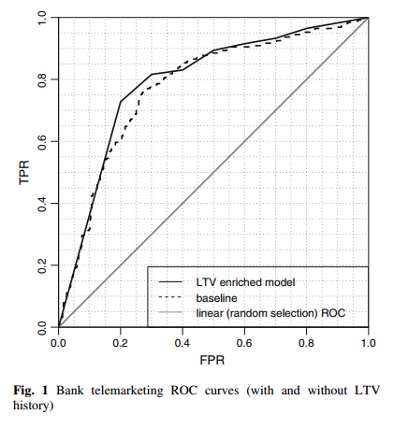

Slide 7
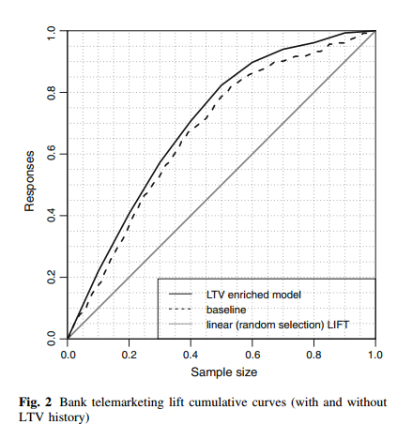

Slide 8
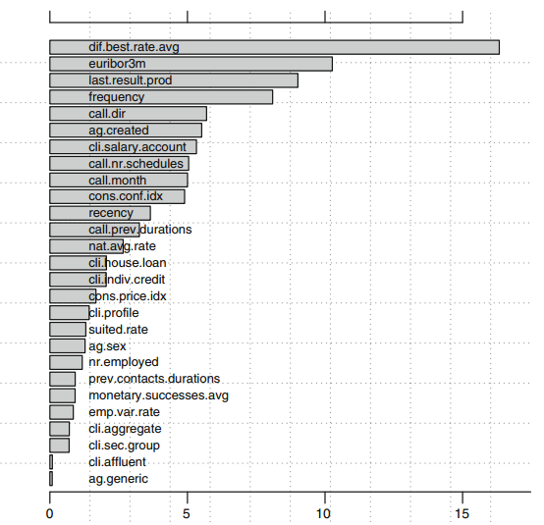

Slide 9
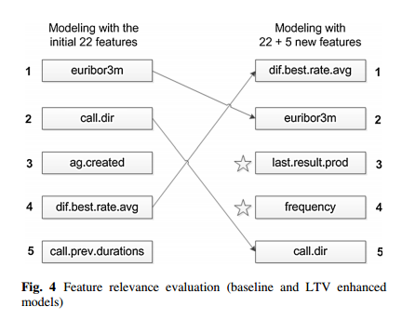

Slide 10
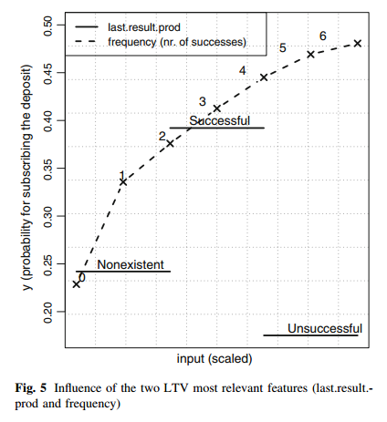

Slide 11
谢谢！

